Slide 1


Slide 2

It began with a holiday to Africa

Slide 3
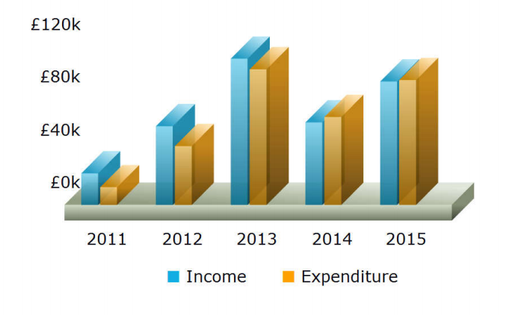
Whisper grows up

Slide 4

Children’s home

Slide 5
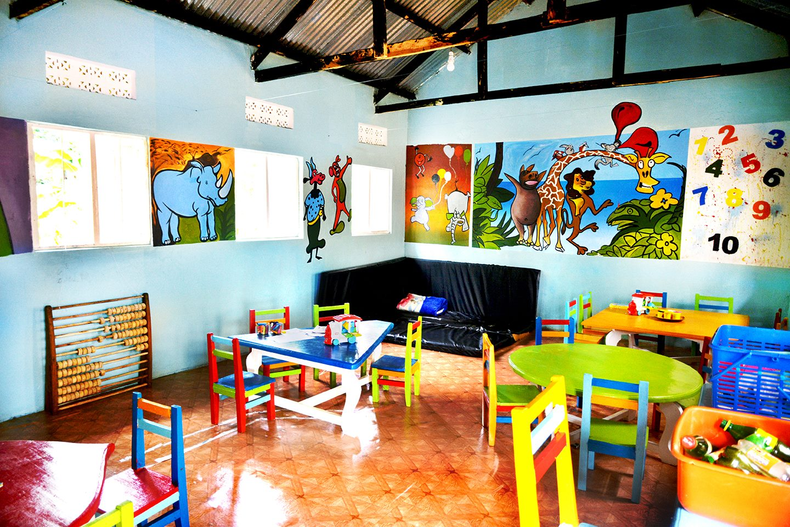
Schooling for 175 children

Slide 6
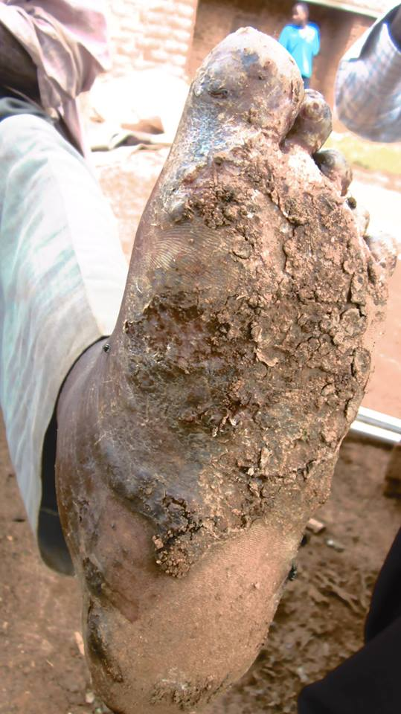
Jigger programme

Slide 7
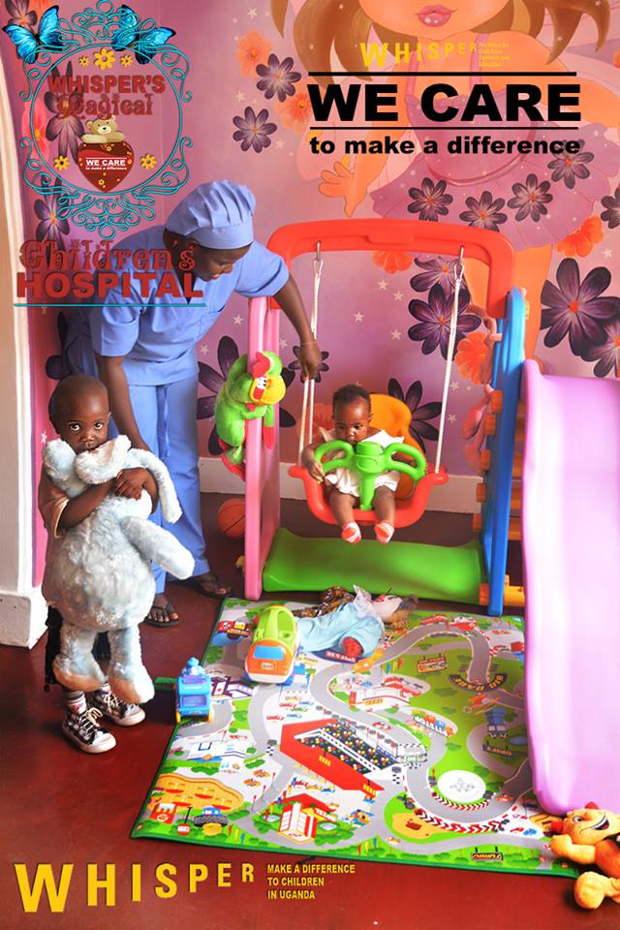
The Magical Hospital

Slide 8

Staff

Slide 9
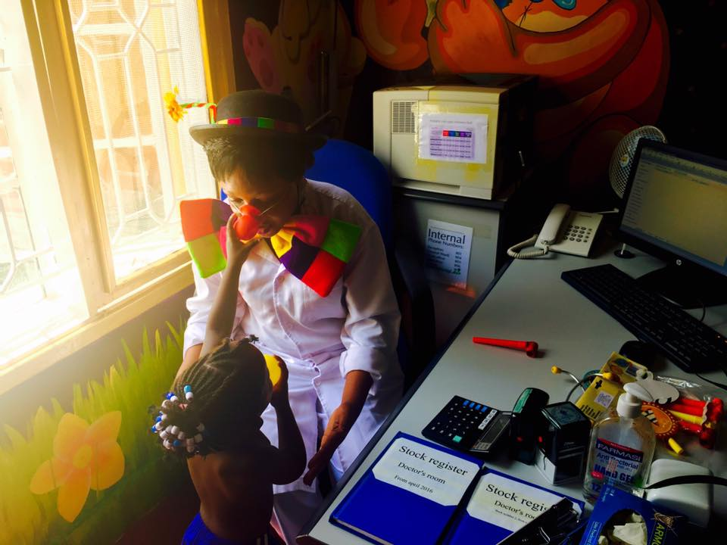
More staff

Slide 10
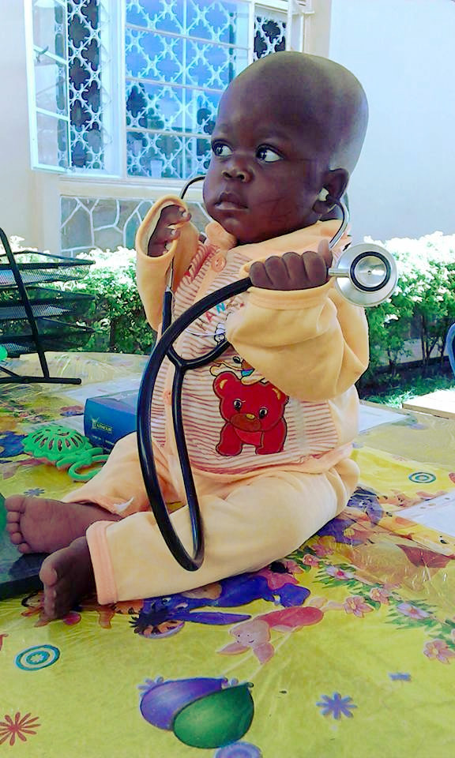
Trainee

Slide 11
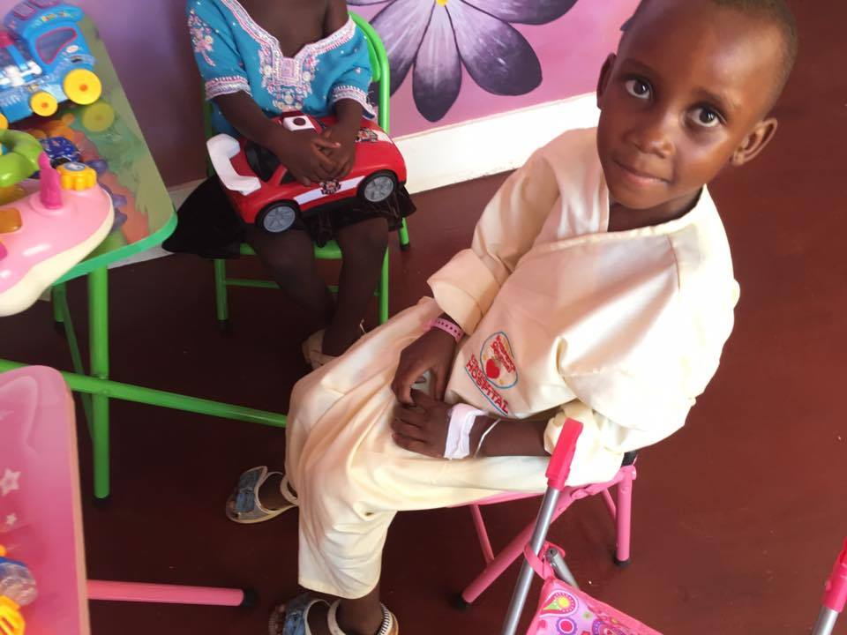
Patients

Slide 12
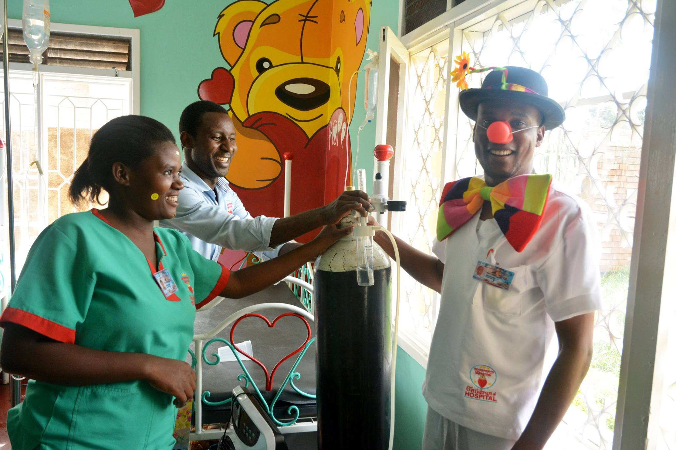
Emergencies

Slide 13
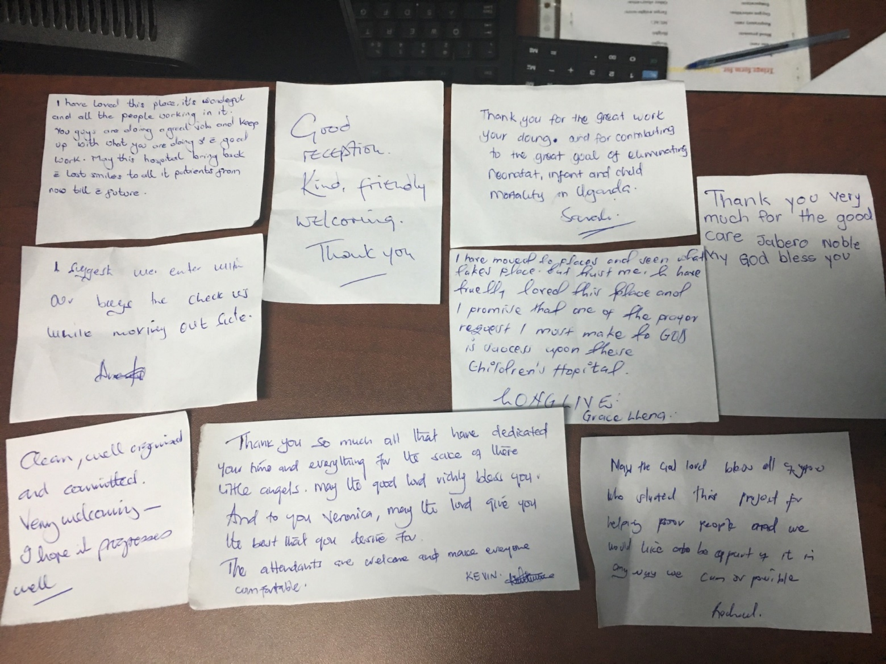
Response

Slide 14

One of many happy customers

Slide 15
Budget
£100k setup costs, amortised over 4 years = £500 per week
£1300 per week running costs of which £300 will come from fees

Slide 16

Cost-effectiveness
Effective Altruism: Against Malaria Foundation saves lives for £2000 each
Whisper saves lives for £1000 or less each (we think!)

Slide 17
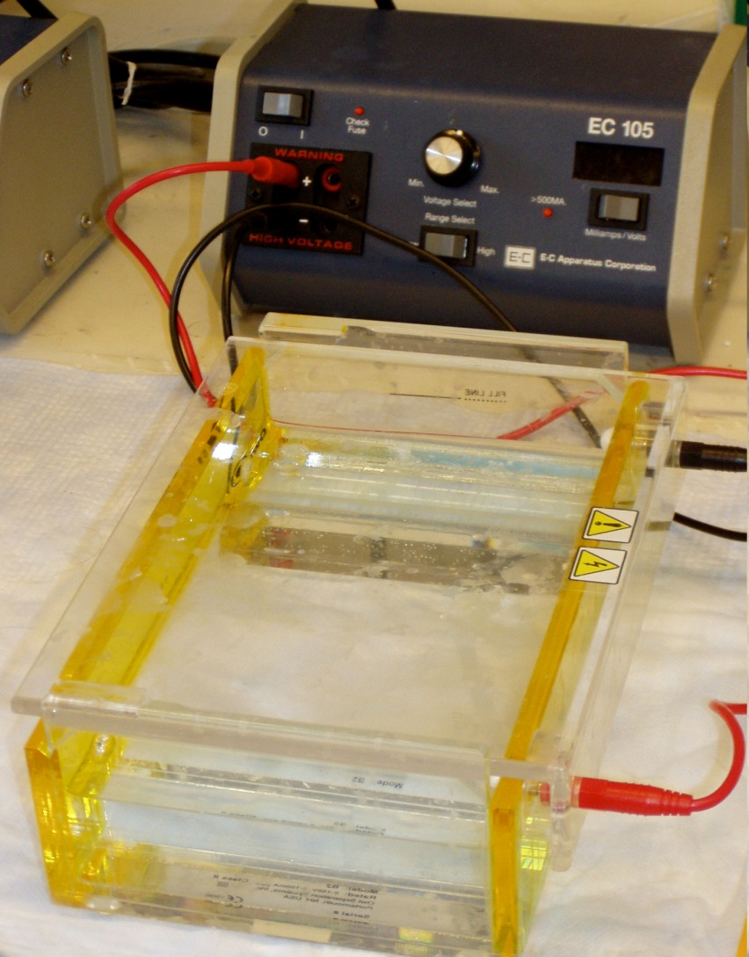
Gel electrophoresis
Photo: https://commons.wikimedia.org/wiki/File:Gel_electrophoresis_apparatus.JPG

Slide 18
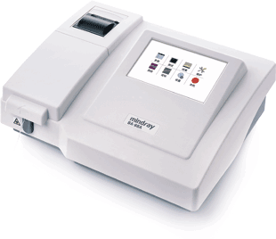
Blood chemistry analyser

Slide 19
Follow us on Facebook
Search for “Whisper’s Magical Children’s Hospital”

